Slide 1

Homework01
JS Output –– Escape Sequences – Data Types - Operators

Slide 2

Before you start!!!
Create
Please create a separate folder called as “homework”
Create
Please create a new file called as “homework01.js” under the homework folder
Do
Do all tasks in the same file
Follow
Please follow the instructions carefully and understand requirements before starting coding
Let
Let TechGlobal Team if any of requirement is not clear or you have any questions related to given tasks below

Slide 3
Task-1
Requirement
-Write a program that outputs below sentences
-Double quotations must be displayed in your console when you run the code
-Every line below must be printed with a separate console.log() statement
I start to practice "JavaScript" today, and I like it.
The secret of getting ahead is getting started.
"Don't limit yourself. "
Invest in your dreams. Grind now. Shine later.
It's not the load that breaks you down, it's the way you carry it.
The hard days are what make you stronger.
You can waste your lives drawing lines. Or you can live your life crossing them.

Slide 4
Task-2
Requirement
-Write a program that prints the whole below text in ONLY 1 console.log() statement (you can use escape sequences to insert line or a tab)
JavaScript is a high-level programming language primarily used to build web applications. It is not limited to the web; it can also be used for the backend development with technologies like Node.js.
It is open source and has a huge community support, which means there are plenty of resources and support available for learning. It uses a syntax like other programming languages and easy to learn.

Slide 5
Task-3
Requirement
-Write a program that stores below information with proper data types and output all variables with separate console.log() statements.
myAge
myFavoriteNumber
myHeight
myWeight
myFavoriteLetter

Slide 6
Task-4
Requirement
-Create 2 variables called as num1, num2 and and store values of 25, 35 in these variables, respectively. Then, output the sum of the numbers with a proper message as given below.
Test Data: 25, 35
Expected output:
The sum of the numbers = 60

Slide 7
Task-5
Requirement
-Create 2 variables called as n1, n2 and and store values of 5, 7 in these variables, respectively. Then, output the product of the numbers with a proper message as given below.
Test Data: 5, 7
Expected output:
The product of the numbers = 35

Slide 8
Task-6
Requirement
-Create 2 variables called as number1, number2 and and store values of 24, 10 in these variables, respectively. Then, output the sum (addition), multiplication, subtraction, division and remainder of these numbers with a proper message as given below.
Test Data: 24, 10
Expected output:
The sum of the numbers is = 34
The product of the numbers is = 240
The subtraction of the numbers is = 14
The division of the numbers is = 2.4
The remainder of the numbers is = 4

Slide 9
Task-7
Requirement:
- Create 2 variables called as i1, i2 and and store values of 7, 11 in these variables, respectively. Then, output the average of the numbers.
Test Data: 7, 11
Expected Output:
The average of the numbers is: 9

Slide 10
Task-8
Requirement:
- Create 5 variables called as a1, a2, a3, a4, a5 and and store values of 6, 10, 12, 15, 17 in these variables, respectively. Then, output the average of the numbers.
Test Data: 6, 10, 12, 15, 17
Expected Output:
The average of the numbers is: 12

Slide 11
Task-9
Requirement:
- Create 3 variables called as b1, b2, b3 and and store values of 5, 6, 10 in these variables, respectively. Then, output the square of each number entered by user.
NOTE: Square of number means number multiplied with itself
Test Data: 5, 6, 10
Expected Output:
The 5 multiplied with 5 is = 25
The 6 multiplied with 6 is = 36
The 10 multiplied with 10 is = 100

Slide 12
Task-10
Requirement:
- Create a variable called as side to be assumed as one side of a square and store value of 7 in that variable. Then, output the area and perimeter for that square.
NOTE: area of a square = side * side
perimeter of a square = 4 * side
Test Data: 7
Expected Output:
The perimeter of the square = 28 The area of the square = 49

Slide 13
Task-11
Requirement
-Write a program that stores below information with proper data types and output all variables with ONLY one console.log() statement.
favBook = JS Algorithms & Data Structures
favColor = Blue
favNumber = 7
Expected output:
The favorite book is JS Algorithms & Data Structures
The favorite color is Blue
The favorite number is 7

Slide 14
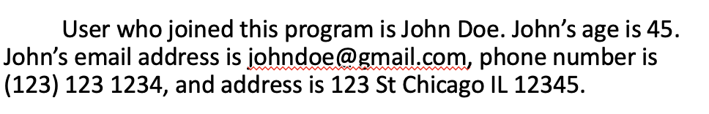
Task-12
Requirement
-Write a program that stores below information with proper data types and output all variables with ONLY one console.log() statement.
firstName = John
lastName = Doe
age = 45
emailAddress = johndoe@gmail.com
phoneNumber = (123) 123 1234
address = 123 St Chicago IL 12345
Expected output: (it should exactly be same as below paragraph)

Slide 15
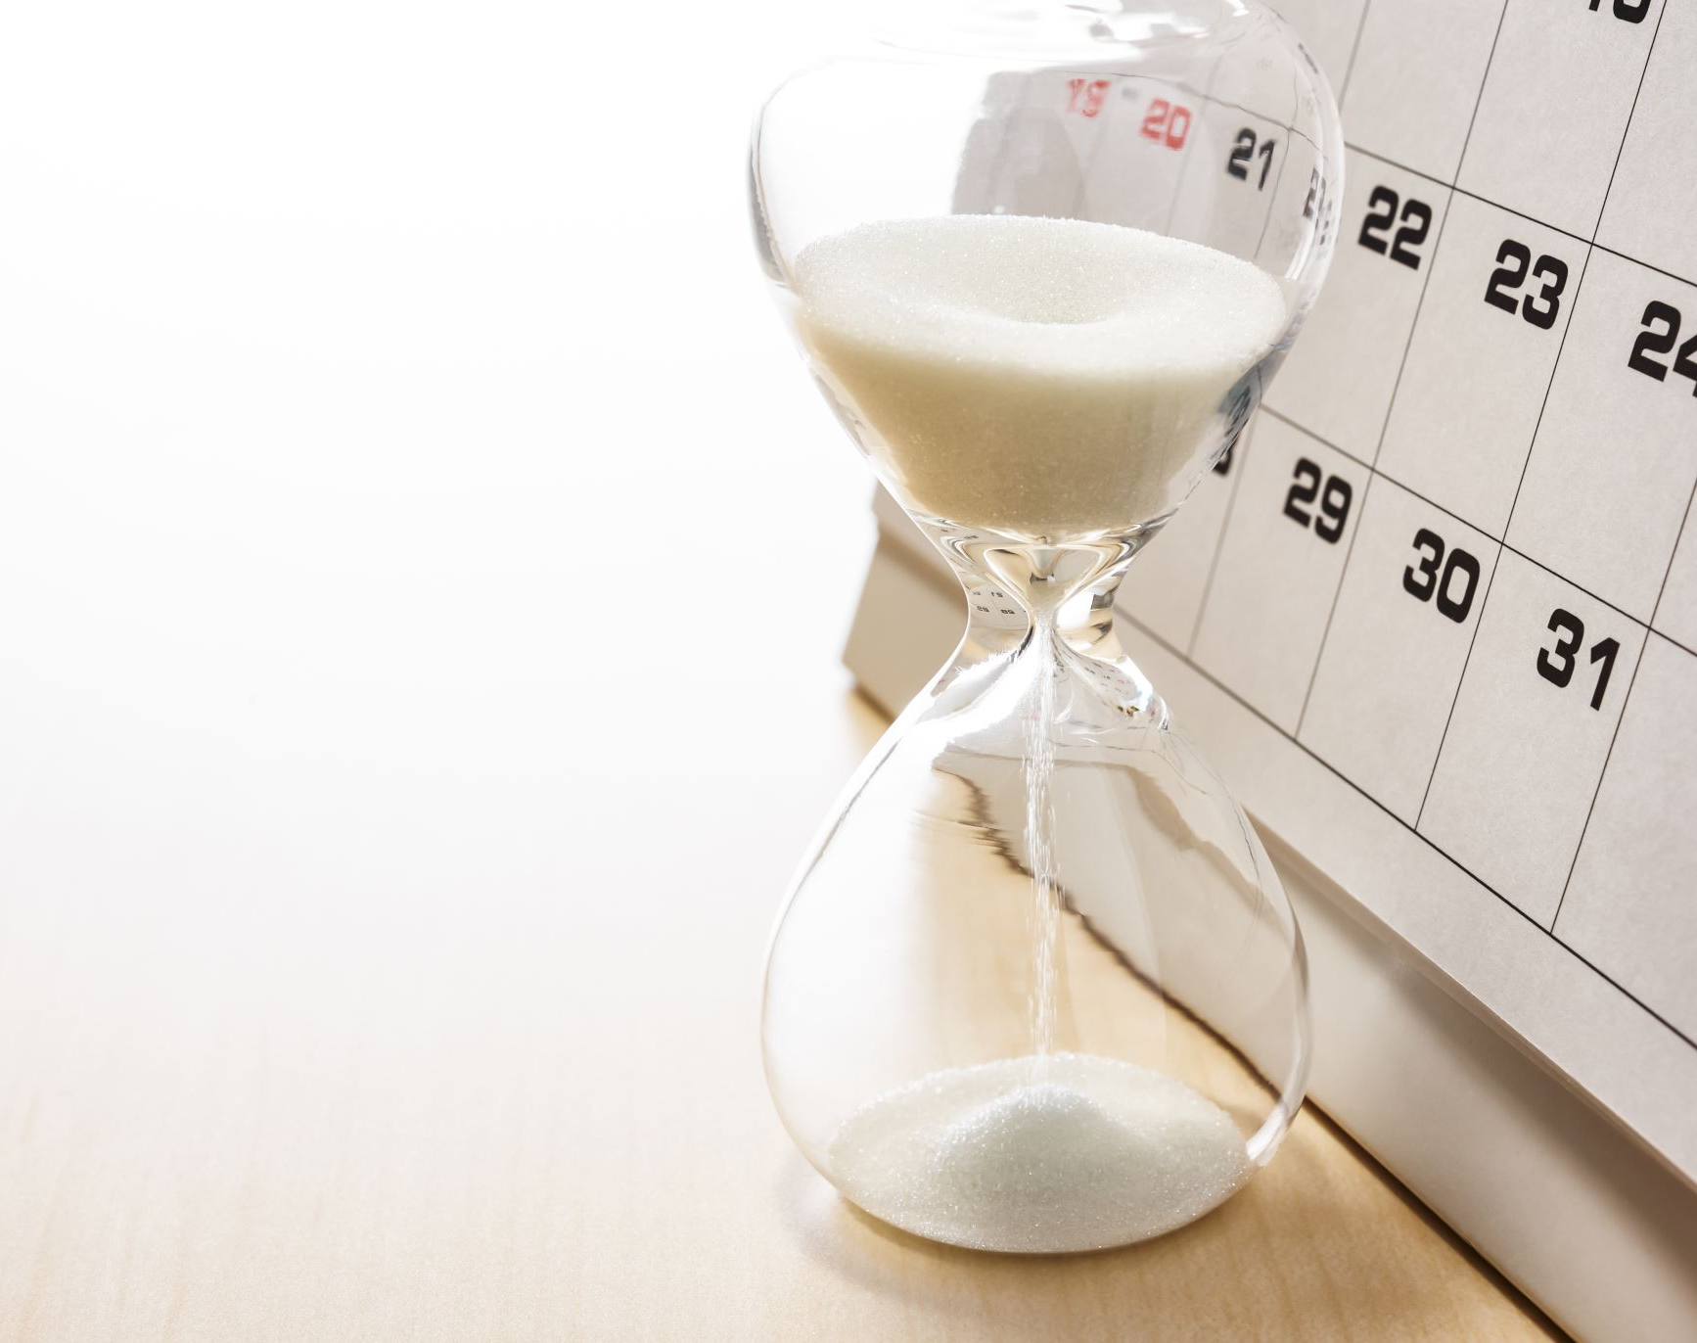
DUE DATE
07/24/2024 4 PM CST
Homework needs to be submitted to Bilal on Slack in private

